Slide 1
Quantile - Quantile Plot
(QQ Plot)

Slide 2
Introduction
Q-Q plot is a scatter plot of two sets of quantiles against each other.
The x-axis displays the theoretical quantiles. This means it doesn’t show your actual data, but instead it represents where your data would be if it were normally distributed.
The y-axis displays your actual data.
If the data values fall along a roughly straight line at a 45-degree angle, then the data is normally distributed.

Slide 3
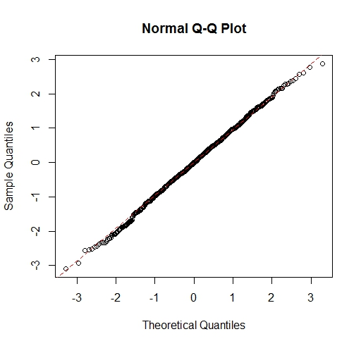
QQ Plot for a normally distributed sample

Slide 4
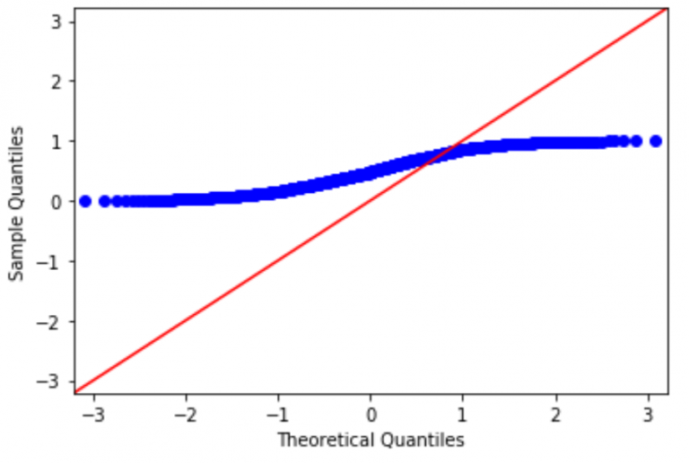
QQ Plot of samples which are not normally distributed

Slide 5
Purpose of the visualization
In most cases, this plot is used to determine whether or not a set of data follows a normal distribution.
All point of quantiles lie on or close to straight line at an angle of 45 degree from x – axis. It indicates that the samples have similar distributions.

Slide 6
Where the visualization can be used.
When we have to check a set of observations are normally distributed.
If a set of observations is approximately normally distributed, a normal QQ plot of the observation will result in an approximately straight line.

Slide 7
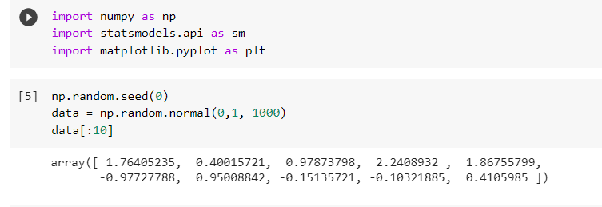
QQ Plot using Python

Slide 8
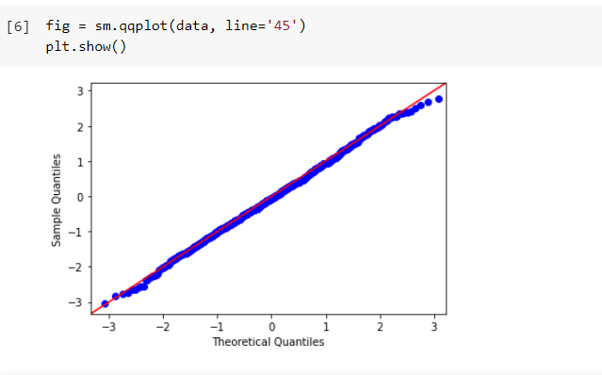

Slide 9
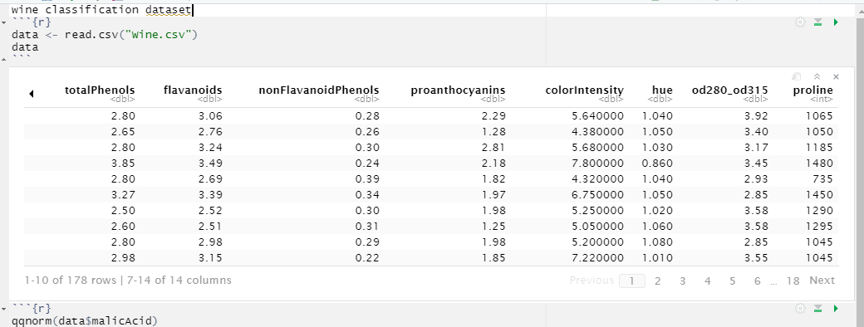
QQ Plot using R
Wine classification dataset

Slide 10
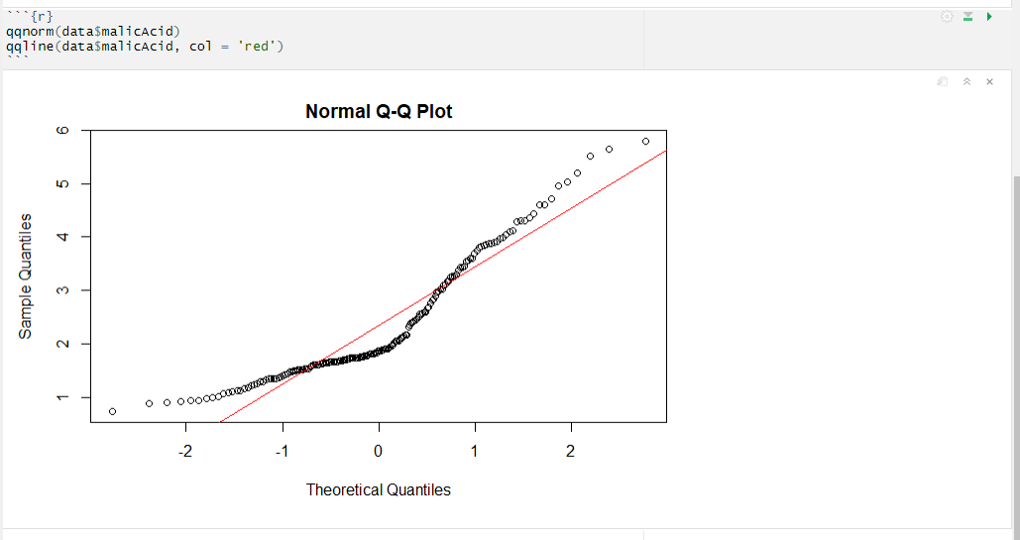
QQ Plot on Malic acid

Slide 11
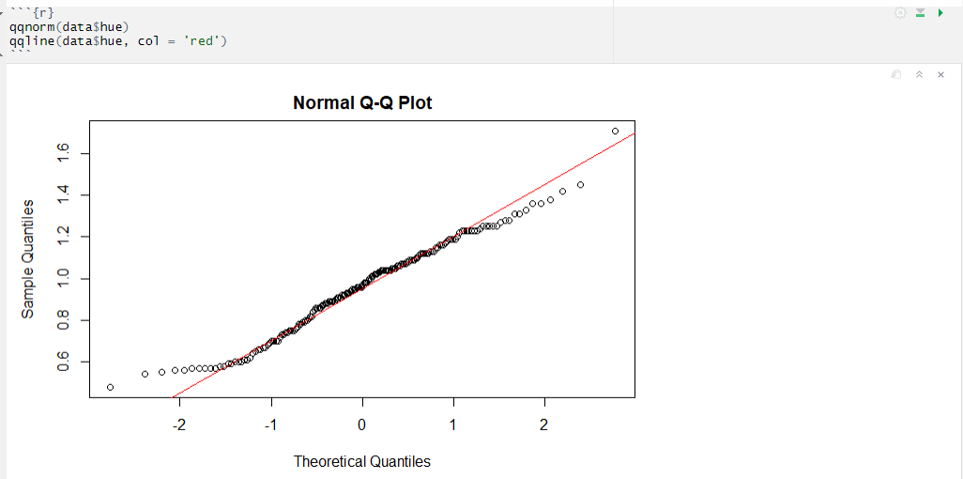
QQ plot on Hue

Slide 12
Thank You

